Slide 1
Borough of Little Ferry
Superstorm Sandy
Public Presentation – Monday, November 19, 2012 at 7 PM

Slide 2
Please read – this presentation best viewed in PowerPoint
This was the public presentation at the Mayor & Council meeting on Monday, Nov. 19.
This has been tweaked to incorporate items discussed during the meeting or to provide clarification.
Please click through the slides as they are not set to automatically go to the next one
Slide #?? is animated; if you do not have PowerPoint on your computer you can download the free viewer here: http://www.microsoft.com/en-us/download/details.aspx?id=13
We posted a PDF knowing not everyone has PowerPoint. Please download the free viewer for best viewing results

Slide 3
Superstorm Sandy Preparation Oct. 22 – Oct 28
DPW begins cleaning out problem catch basins
DPW lowers Willow Lake to allow it to hold more water
DPW inspects all pump stations to ensure their operation
DPW inspects all generators to ensure their operation
DPW stages various vehicles around the Borough for access in the event of flooding
Additional backup generators secured (if needed)
Sandbags distributed

Slide 4
Superstorm Sandy – The Berm
What is a BERM? From Wikipedia:
Berms are also used to control erosion and sedimentation by reducing the rate of surface runoff. The berms either reduce the velocity of the water, or direct water to areas that are not susceptible to erosion, thereby reducing the adverse effects of running water on exposed topsoil.

Slide 5
The Berm
“Owned” by The Meadowlands Conservation Trust
Approximately 5 to 6 feet high
Maintained by private company as contracted by the Trust
Damaged last year by Hurricane Irene – repaired
Repaired a few days after Superstorm Sandy
Six breaches occurred from the tidal flood waters

Slide 6
Superstorm Sandy – Data Part I
The following slide demonstrates the data from the Meadowlands Environmental Research Institute (MERI)
Data taken from the Barge Marina in Carlstadt
Data highlights –
Tidal water reached 8 feet 6 inches
Twice as much salinity (salt) as normal

Slide 7
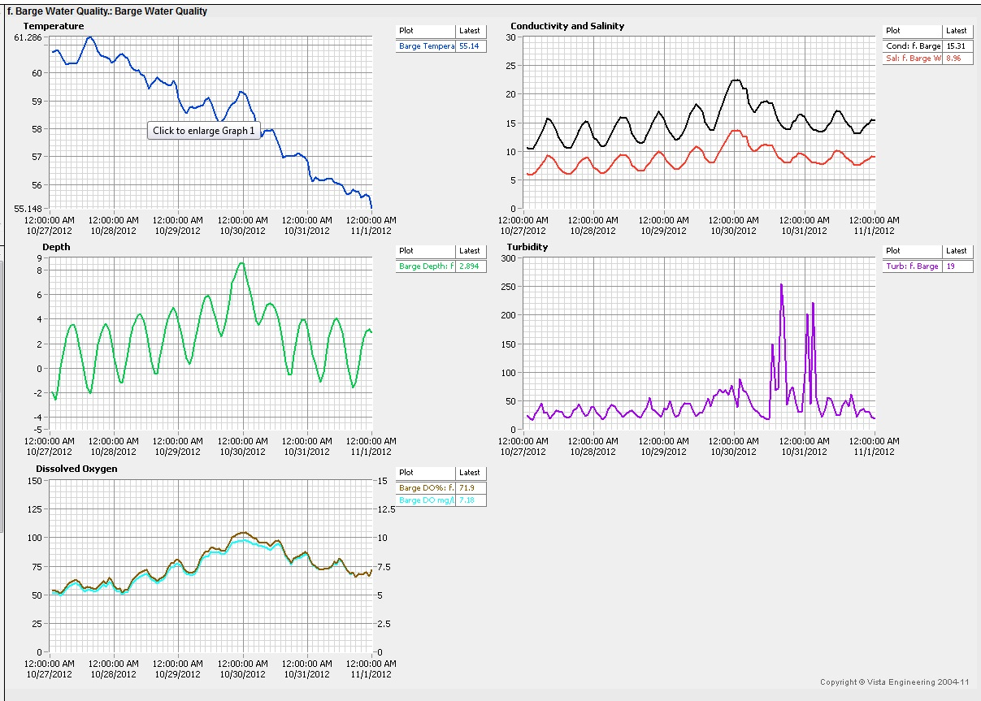
Barge Marina Water Parameters Oct. 27th. – Oct. 31st.

Slide 8
Superstorm Sandy – Data Part II
Next slide shows water levels
The red line is the Berm
Note the times at the peak. This demonstrates that there was 7 feet of tidal water entering Little Ferry and surrounding towns from 8 PM on the 29th to 2 AM on the 30th
The wind was keeping the water in during this time

Slide 9
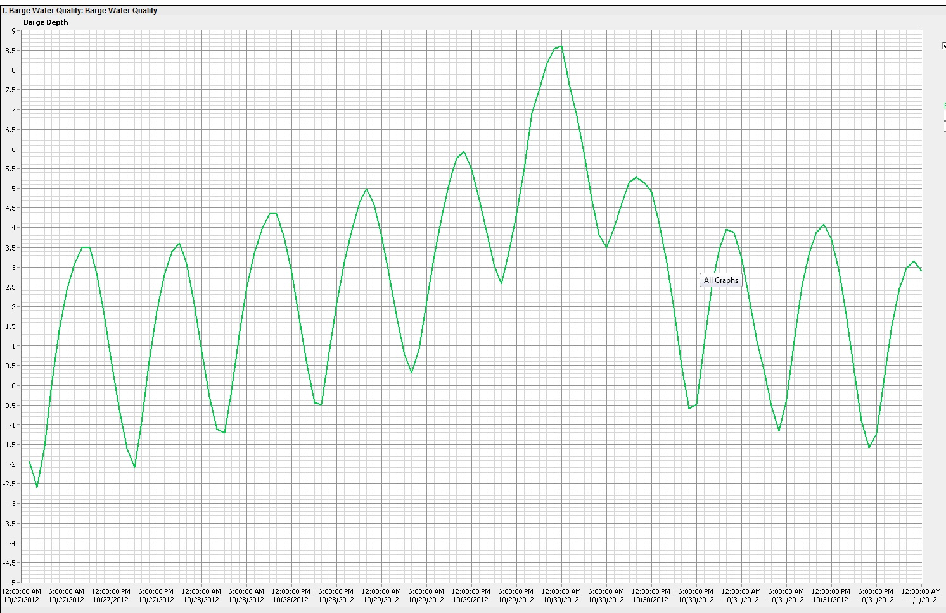
Barge Marina Water Level Oct. 27 - Oct. 31
8.6 Feet
8PM
2AM
East Riser 6.4 Feet
Losen Slote 6.0 Feet
West Riser 3.7 Feet
Midnight Oct 29th.
Saturday
Sunday
Monday
Tuesday
Wednesday

Slide 10
Tidal Flood Waters – A Generalization
The next slide is an approximation on what occurs during “X” amount of feet of tidal water
The yellow T is tide gates
The solid red coloring is areas that the tide gates are protecting – no flooding is occurring
Light blue coloring are areas that would experience flooding at that water height
The slide starts at 2 feet and ends at 8 feet of tidal flooding
The slide is animated so please ensure animation is permitted in PowerPoint – click through to see the animation

Slide 11
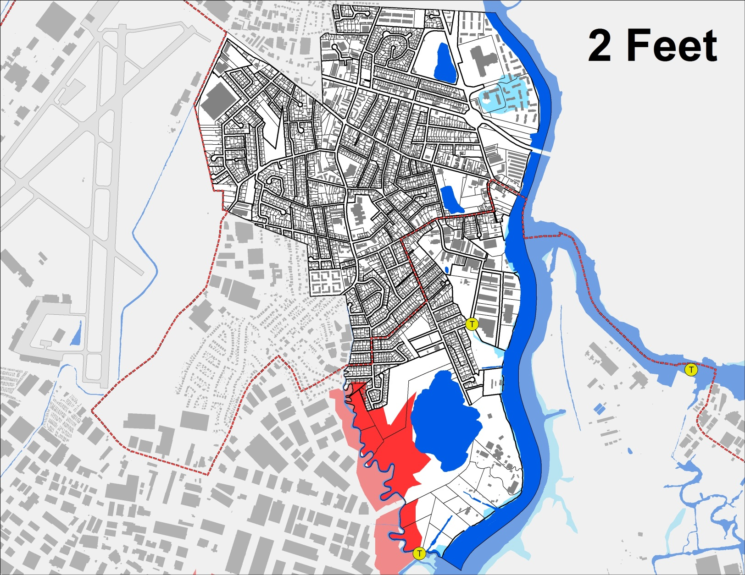
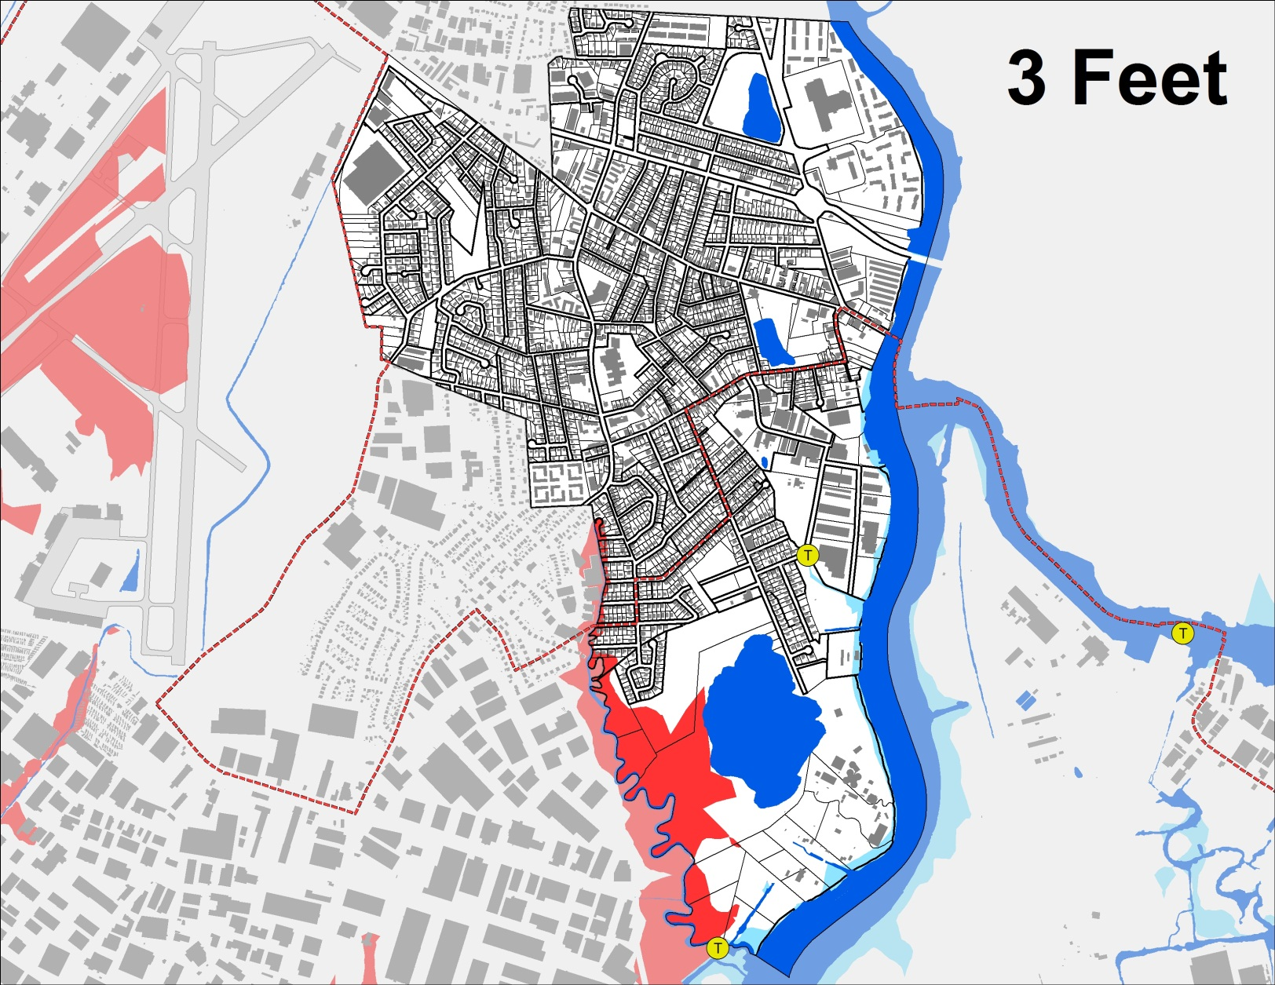
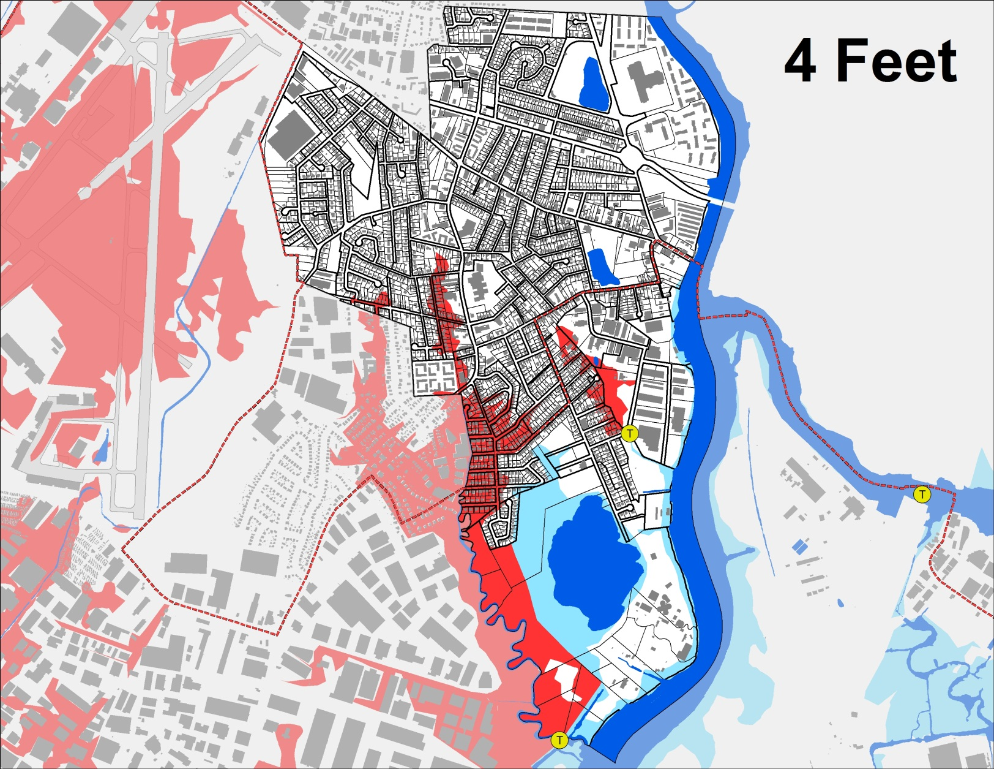
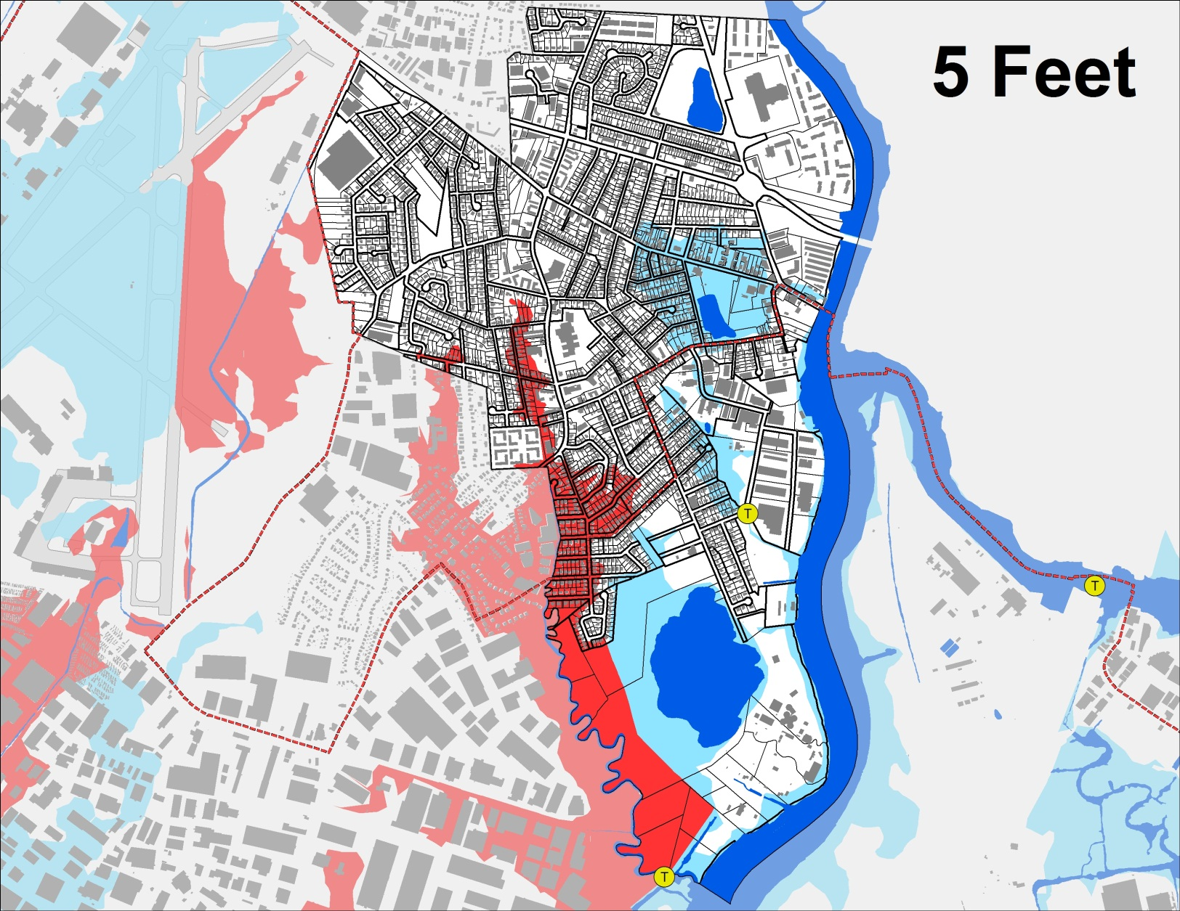
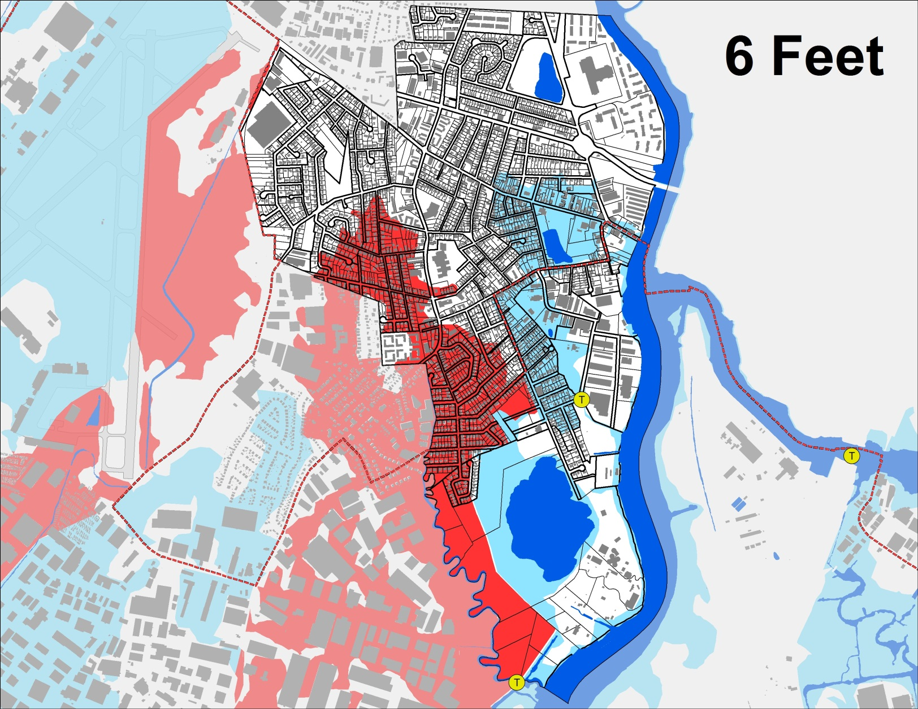
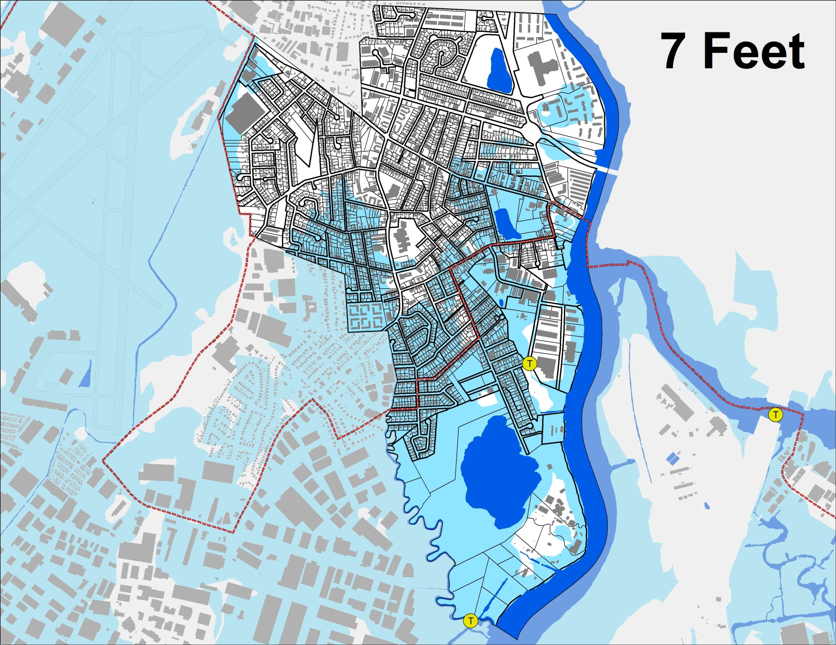
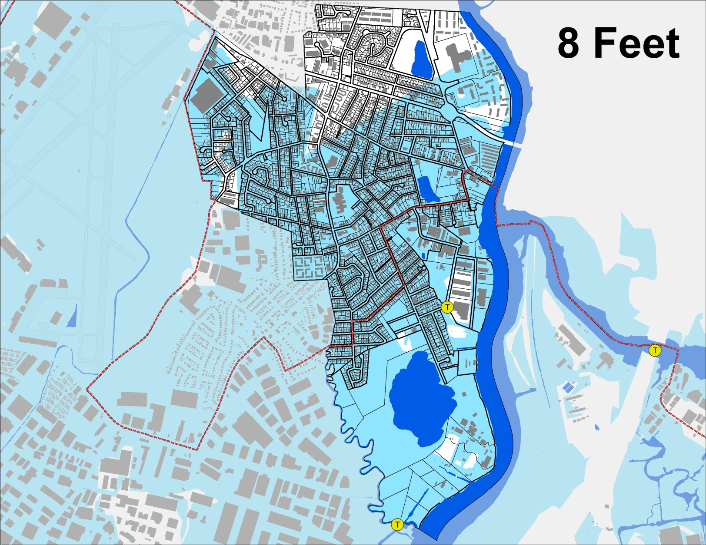
Little Ferry

Slide 12
Superstorm Sandy – Summary of Tidal Flood Waters
MERI had tidal waters at a height of 8 feet 6 inches
Borough Engineer found average tidal water elevations at 8.65 feet
Same elevation also found in Hackensack
Water went over any existing Berm or tide gate; both have maximum height of six feet
Water went over the NJ Turnpike – 10 to 20 feet high in spots
There simply was too much water that was too high for existing infrastructure to handle

Slide 13
Willow Lake Park Area
Why did it take Main and the surrounding streets so long to drain?
These streets drain to Willow Lake. Since the Lake was filled with water – there was no place for the water to go. The tide was kept in due to the high winds so the pumps could not pump out any water. There are two pumps and one pump took on water and stopped working.
Once the water started to recede, other Fire Departments assisted us in pumping out the Lake. Additionally, we secure five pumps, with hoses six inches wide and utilized those to help pump out the Lake

Slide 14
Superstorm Sandy – Immediate Response
Rescues occurring all night long on October 29
Emergency Command Center created by County and National Guard at Vo-Tech in Teterboro
Rescues commenced at 8 AM on Tuesday, October 30 by National Guard
Used “deuce and a half” vehicles and boats
Helicopter rescue (one or two)
Other municipalities assisted in rescue (Little Falls, Wayne, Franklin Lakes, etc)
Approximately 820 evacuations combined in Little Ferry & Moonachie
NO FATALITIES

Slide 15
Superstorm Sandy – Borough pre-storm public information efforts
Reverse 9-1-1 call on Sunday morning, the 28th advising of sandbags, evacuation planning and emergency shelter
Same information posted to Facebook and website
Information posted to Facebook and website on the evening of the 28th
Monday, the 29th – Facebook and website post about PSE&G, weather

Slide 16
Reverse 9-1-1
The Borough utilizes the County’s Swiftreach Network system
This is a different provider than last year – that is why some people received a call while others did not
Working on obtaining why not everyone is in the company’s database
Posted to Facebook and website where to register online for Swiftreach (October 29th)

Slide 17
Borough Public Information and Outreach
Reverse 9-1-1 calls
October 28 at 11:57 AM
October 29 at 11:39 AM
October 29 at 6:51 PM
October 29 at 10:09 PM
November 2 at 6:50 PM
November 5 at 5:44 PM
November 9 at 8:33 PM
November 19 at 4:00 PM

Slide 18
Borough Public Information and Outreach Part II
Facebook and website posts
All Reverse 9-1-1 call information posted online
Q&A posted November 5
November 7 additional information posted for local businesses
November 13 miscellaneous information

Slide 19
Borough Public Information and Outreach Part III
Building Department teamed with National Guard vehicles to answer questions – they were driving around for 2 days
Borough created informational handout passed out by FEMA, Building Dept. staff w/National Guard, at shelter…similar information based upon online posts
Building Department out from 9 AM – 4 PM on Saturday, November 3 to answer questions
Mayor met with individuals; during driving inspections --- handout out informational flyer

Slide 20
Personal recovery efforts
Temporary housing shelter led by Bergen County OEM
Local evacuations shelters flooded – both schools and Church
Local efforts include:
Food and cleaning material distribution at St. Margaret’s Church
Coordination with the Volunteer Center of Bergen County
Work with PSE&G once substantial power is returned to the region to restore power to pockets that hadn’t received it yet
Rumor that was heard - boil water advisory -There was no boil water advisory at any time during the Storm

Slide 21
Personal recovery efforts – Part II
Waiving of building permit fees – both State and local
Get a permit – it is a record to protect you that work was done
Permits can be obtained after work is complete
Tax deadline extended until November 30
St. Margaret’s food pantry will be open once a week
Review of public and quasi-public spaces for debris removal in compliance with DEP regulation
Fire Department pumped out basements
CERT coordinating with Church

Slide 22
Borough property lost/damaged
6 police cars
2 Fire Chief vehicles
1 DPW truck
Goose poop machine
Senior Bus (senior services currently suspended)
Various fencing, small equipment, etc
2 ambulances
Other items to be added as equipment is reviewed

Slide 23
Borough cleanup efforts - removal of debris
Started Thursday after the storm
Three companies involved at any one time – four total were used
Will continue until November 30 as that is when FEMA is saying reimbursement is going to end
Determined not to utilize containers this time due to the large amount of debris – just wouldn’t fit and create a hazard
Only storm related debris will be picked up
Recycling commences November 21
How is debris removed ?
Borough is broken down into 3 sections where haulers are instructed to go

Slide 24
Property values
State is currently working on a mechanism to address large scale re-assessment of damaged property due to municipalities by the end of this week
We know nothing more about this – conference call with Governor’s office earlier today they had no new information to share
From speaking to tax assessors around the State – initial drop in sale prices but return to pre-storm pricing in three to six months (yes this is hard to believe)

Slide 25
Municipal Taxes – How will the storm impact taxes
Cleanup costs are estimated to be no more than $3.50 a month over a five year period in your municipal tax bill – this is based upon FEMA and insurance reimbursements and is only an estimate
Again - this is a high end estimate dependent on final FEMA and insurance reimbursements
The Borough does not set the school tax rate

Slide 26
Planning efforts
Mailing to residents by end of year with information on how to register with Swiftreach and Nixle; general storm update
AM Radio? How can Borough utilize this to notify residents?
Work with Meadowlands Conservation Trust to raise the berms
Work with Governor’s Office to raise the berms – weekly conference calls with his Office
Long range planning of additional tide gate(s)
Work with Federal government on early warning system – we have been told that the National Oceanic and Atmospheric Administration (NOAA) sensors failed due to the strength of the storm
Wave of 32 feet hit Sandy Hook

Slide 27
Closing remarks
Thank you volunteers, staff and other governments that provided assistance

